Slide 1
Room Persistence
Alexa Grau, Tanmay Khandelwal, Andrew Knaus, Aman Mishra, Rishabh Nair

Slide 2
What is room persistence?
Room is one of the libraries included in Android Jetpack
Helps developers follow best practices, eliminate boilerplate code, and reduce fragmentation
The Room persistence library provides a layer of abstraction over SQLite
SQLite is powerful, but is low-level and can require a lot of time and effort
To specify operation for retrieval, updation and deletion
To add constraints, such as foreign keys
Support for LiveData
Room provides
Compile-time verification of SQL queries.
Convenience annotations that minimize repetitive and error-prone boilerplate code.
Streamlined database migration paths.
Notes:
Person 1

Slide 3
Room | SQLite
No need to write raw queries | Must write raw queries
Compile-time verification of SQL queries | No compile-time verification of SQL queries
Room internally maps Database Objects to Java | Must convert Data to Java Objects through queries
Supports integration with other Architecture components | Lots of boilerplate code to integrate with other Architecture components
Provides easier way to work with LiveData | Must use external code to access LiveData
If the database schema changes, there’s no need to change the code | Queries must be updated whenever the database schema is changed
Notes:
Person 2
https://www.geeksforgeeks.org/overview-of-room-in-android-architecture-components/

Slide 4
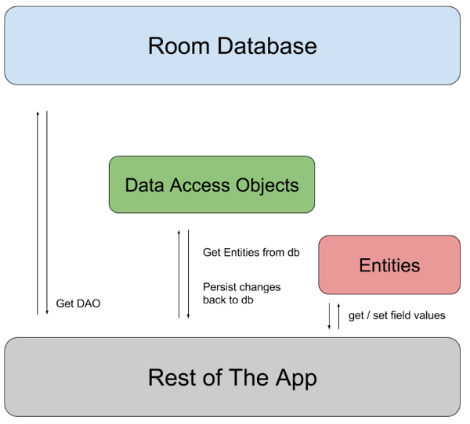
How to implement room persistence
Notes:
Person 2
Image: https://gorillalogic.com/blog/android-room-tutorial-simplifying-how-you-work-with-app-data/

Slide 5
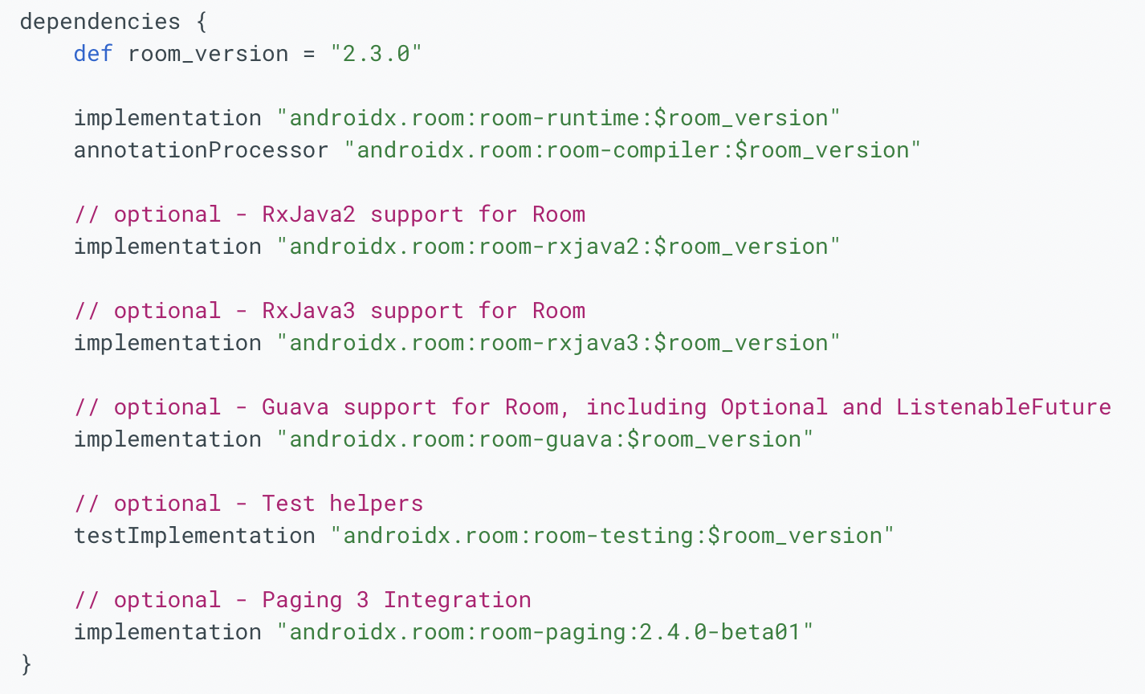
Dependencies for using Room
Add from the following dependencies for the artifacts you need in the build.gradle file for your app.
Notes:
Person 2
https://medium.com/mindorks/using-room-database-android-jetpack-675a89a0e942

Slide 6
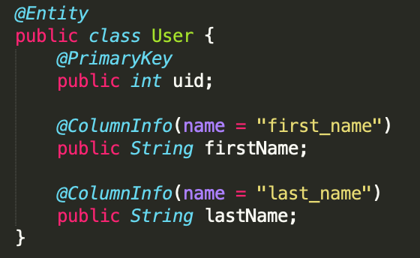
Components of a Room DB - Entity
Represents a table in the DB
Important: mark at least one field with @PrimaryKey annotation.
Implement the constructor, override getter and setter for each field, and optionally override equals or toString.
The following code defines a User data entity. Each instance of User represents a row in a user table in the app's database.
Notes:
Person 3
https://medium.com/mindorks/using-room-database-android-jetpack-675a89a0e942

Slide 7
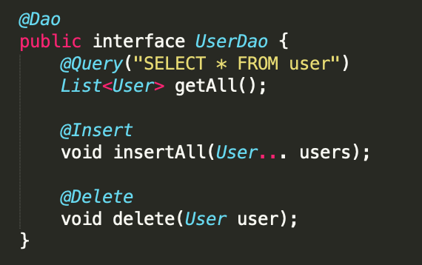
Components of a Room DB - DAO
Data Access Object
Define methods that access the database
The DAO acts as a contract to perform CRUD operations on data within a database.
Notes:
Person 3

Slide 8
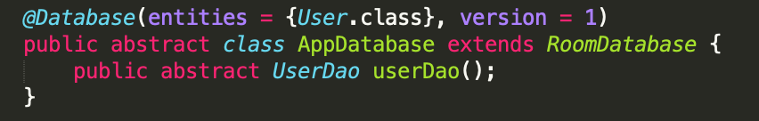
Components of a Room DB - Database
Create with an abstract class that extends RoomDatabase
Add version and entities to database as @Database(entities = {<Entity>.class}, version = 1).
List the DAOs which access the entities in Database.
Notes:
Person 3

Slide 9


Room DB - Database Usage
Create an instance of the database:
use the abstract methods from the AppDatabase to get an instance of the DAO. Use the methods from the DAO instance to interact with the database:
Notes:
Person 3

Slide 10
Code Overview

Slide 11
Demo

Slide 12


